Slide 1
Bones
Notes:
This image is stretched a little bit – it might work for now – but we could also use one of Walden’s pictures as the cover (see next page).

Slide 2
Whose bones are these?

Slide 3
Bones of a Jackfish.

Slide 4
Whose bones are these?

Slide 5
Bones of a polar bear.

Slide 6
Whose bones are these?

Slide 7
Bones of a beluga.

Slide 8
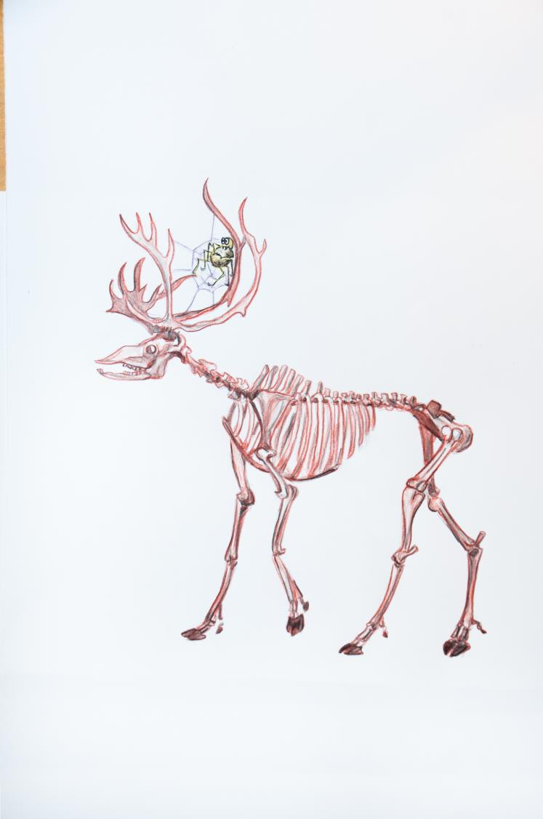
Whose bones are these?

Slide 9
Bones of a caribou.

Slide 10
Whose bones are these?

Slide 11
Bones of a beaver.

Slide 12
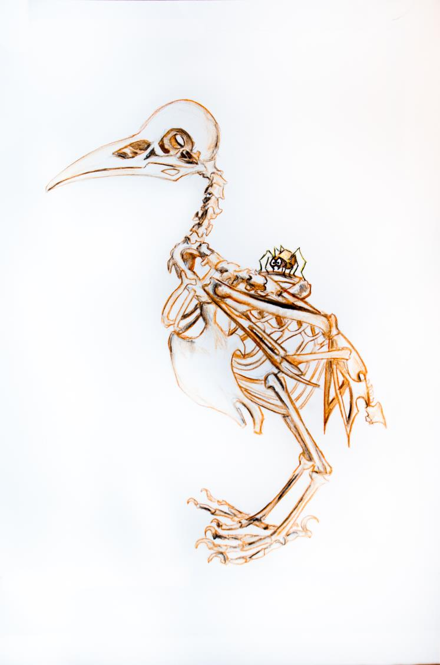
Whose bones are these?

Slide 13
Bones of a raven.

Slide 14
Whose bones are these?

Slide 15
Bones of a vole.

Slide 16
Whose bones are these?

Slide 17
Bones of a wolf.

Slide 18
Who has no bones?
Notes:
Should we say exo-skeleton?
Or
Who wears their skeleton on the outside?
Or
Who sheds their skeleton?

Slide 19
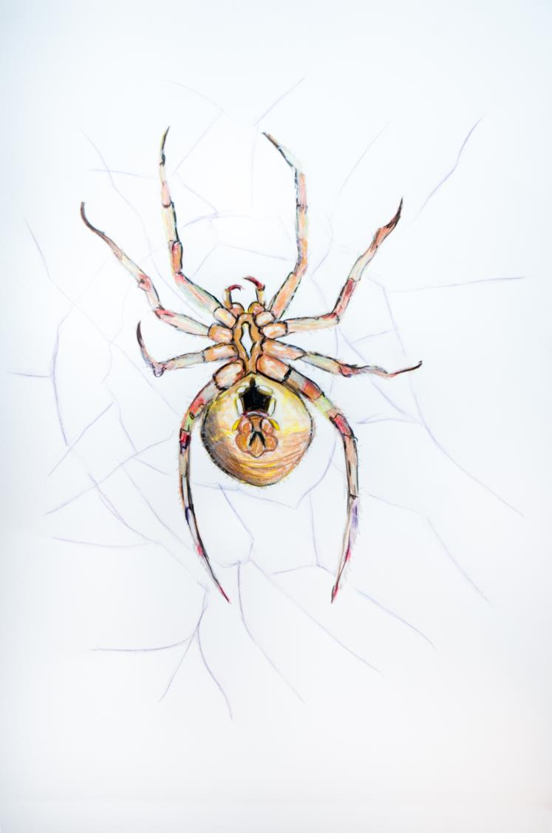
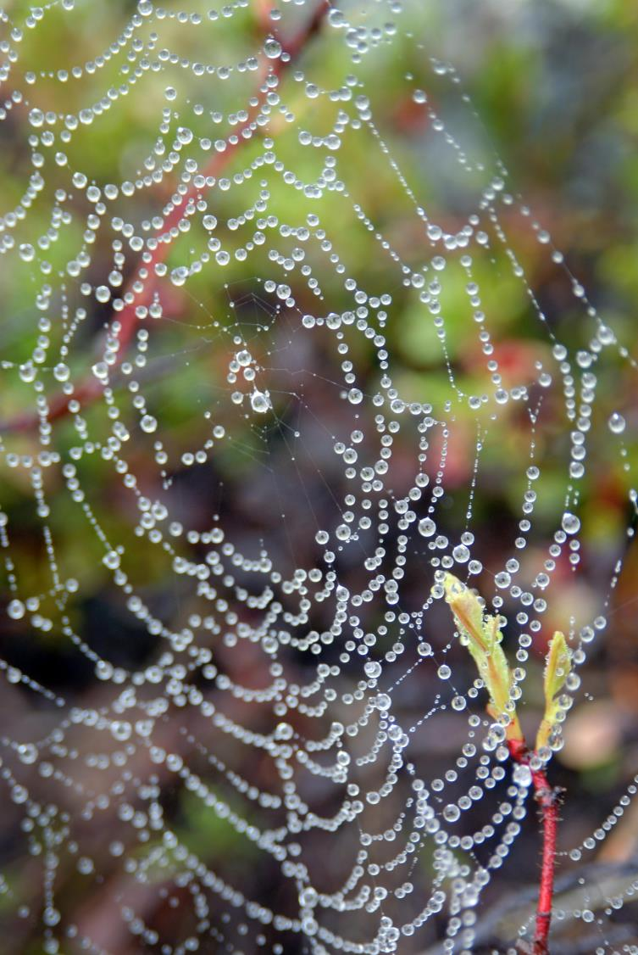
A Spider!

Slide 20
Ideas
For each page ask, ‘where is the spider’. Encourage the students to use placement words such as on, inside, under and body parts such as head, leg. An example of a full sentence would be ‘the spider is on the vole’s leg’.
Ask students where the animals live. For example, ‘fish live in the water; or ‘the polar bear lives on the tundra’.

Slide 21
Acknowledgements
All drawings by Jen Walden.
Tessa Macintosh photos: spider web, raven
Paul Vesci photo: jackfish
GNWT – ENR photos: polar bear (Be41 Polar Bear –RWED), beluga (RDecker), caribou (NWT2009-07-23DSC_0494), vole (RB), wolf (Dean Cluff, Ellsmere,08Jul2010)
Beaver photo: http://www.flickr.com/photos/31563480@N00/2452702213/ American Beaver]
Adapted by Wendy Lahey from the book Les Squelettes by Kevin Polsello.

