Slide 1
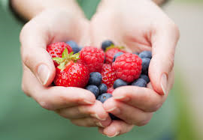
I Love Berries

Slide 2
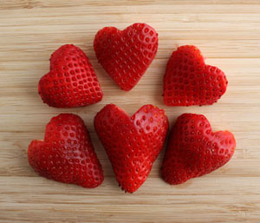
Strawberries, strawberries, strawberries I love strawberries.

Slide 3
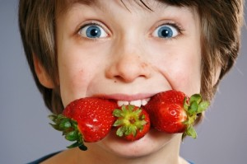
I eat strawberries in the morning.

Slide 4
I eat strawberries at night.

Slide 5
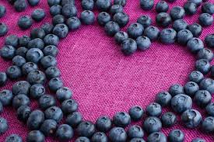
Blueberries, blueberries, blueberries I love blueberries.

Slide 6
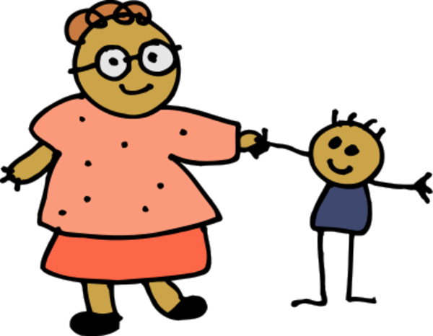
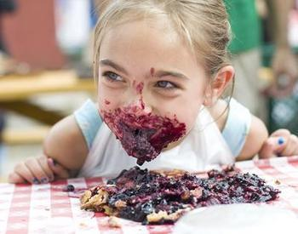
I eat blueberries with my mom.

Slide 7
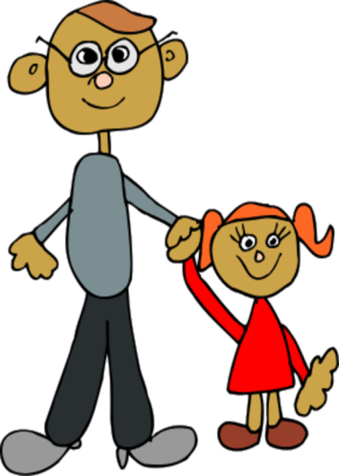
I eat blueberries with my dad.

Slide 8
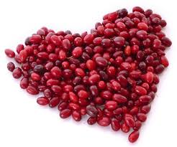
Cranberries, cranberries, cranberries I love cranberries.

Slide 9
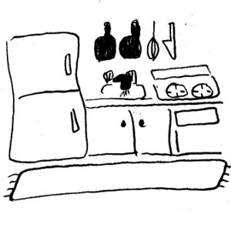
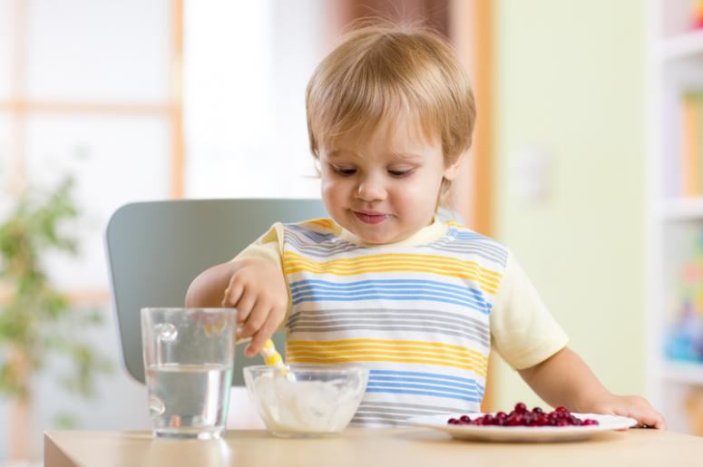
I eat cranberries in my kitchen.

Slide 10
I eat cranberries in my room.

Slide 11
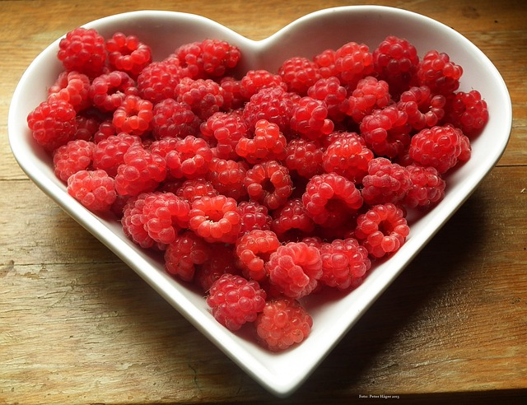
Raspberries, raspberries, raspberries I love raspberries.

Slide 12
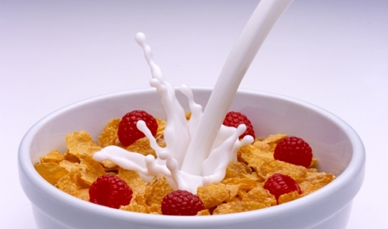
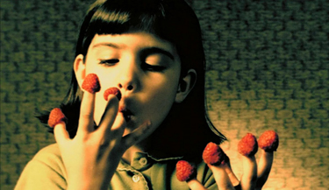
I eat raspberries on my cereal.

Slide 13
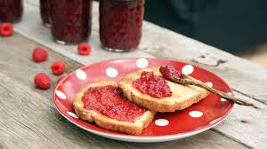
I eat raspberries on my bread.

Slide 14
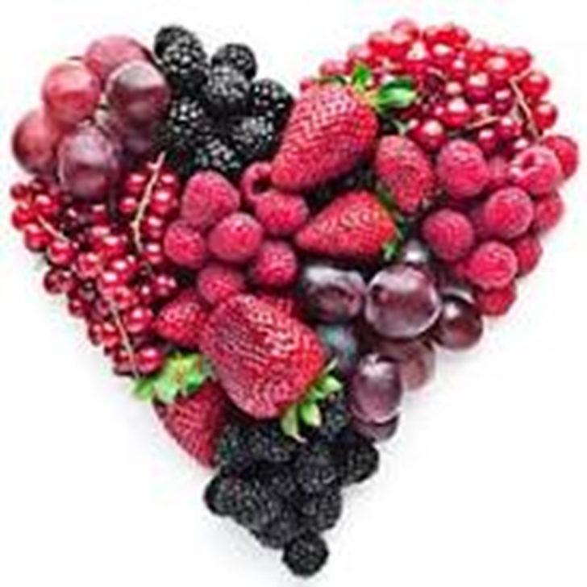
Berries, berries, berries. I love berries.

