Slide 1
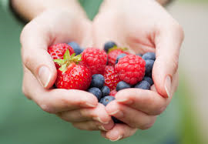
I Love Berries

Slide 2
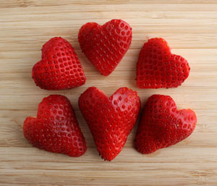
Strawberries, strawberries, strawberries I love strawberries.

Slide 3
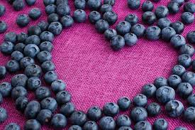
Blueberries, blueberries, blueberries I love blueberries.

Slide 4
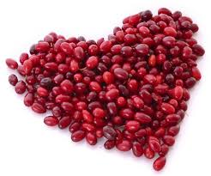
Cranberries, cranberries, cranberries I love cranberries.

Slide 5
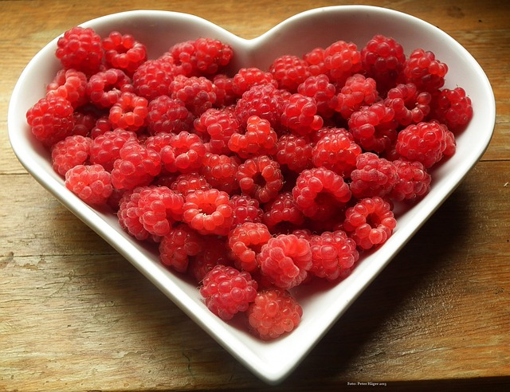
Raspberries, raspberries, raspberries I love raspberries.

Slide 6
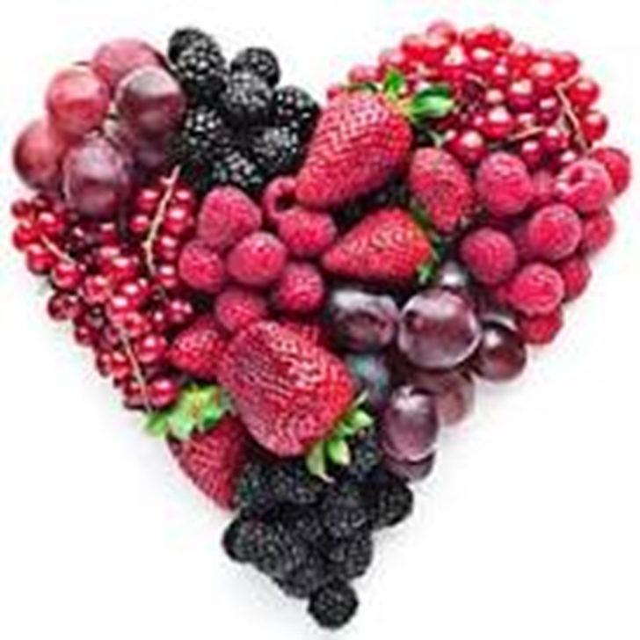
Berries, berries, berries. I love berries.

