Slide 1
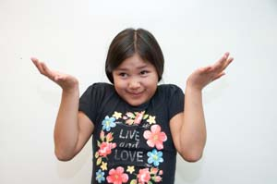
How are you?

Slide 2
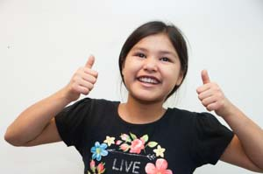
I am really good.

Slide 3
How is he/she?

Slide 4
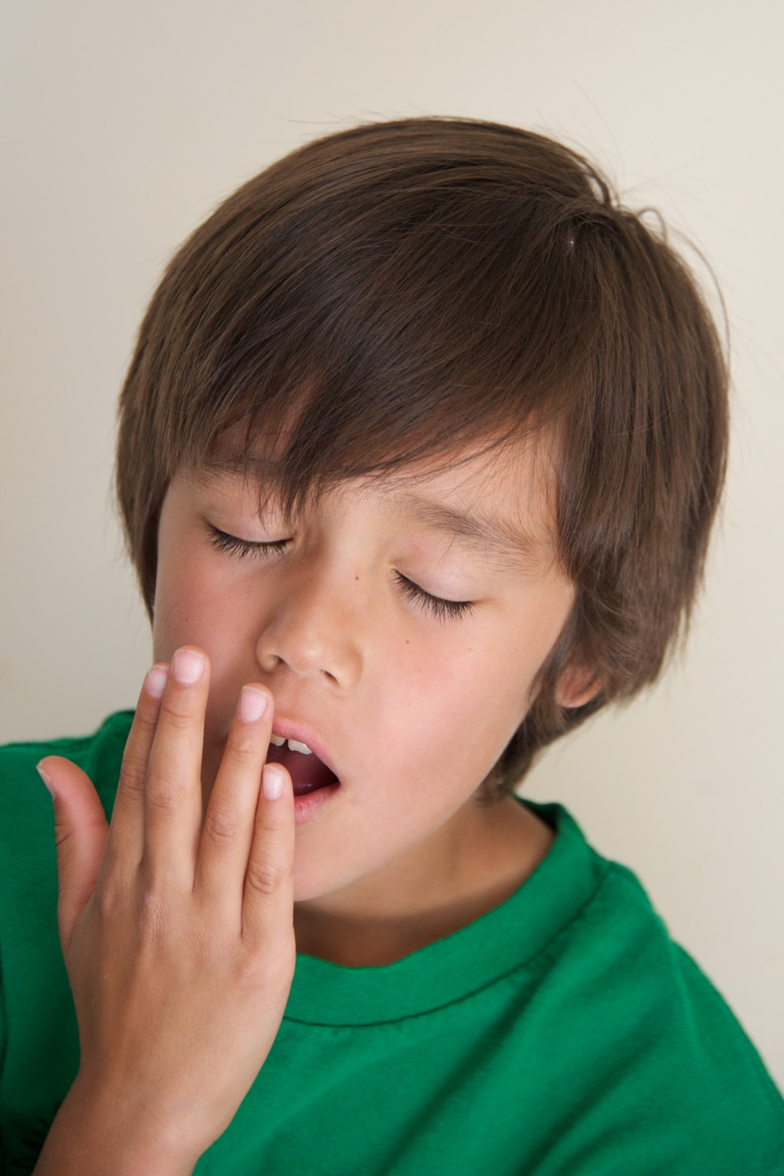
He is tired.

Slide 5
How are you?

Slide 6
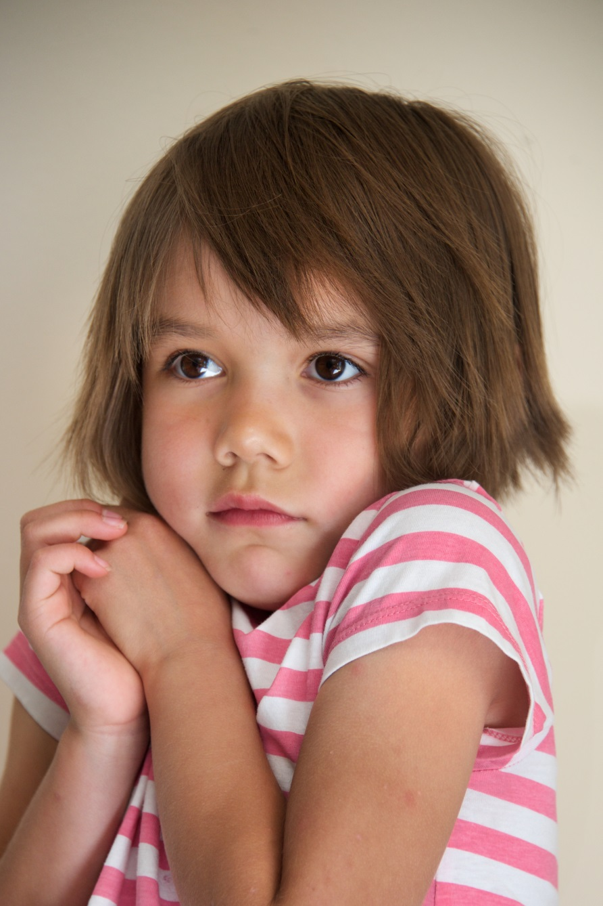
I am shy.

Slide 7
How are you?

Slide 8
I don’t know.

Slide 9
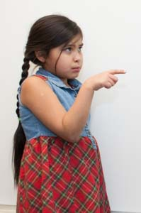
What about you?

