Slide 1
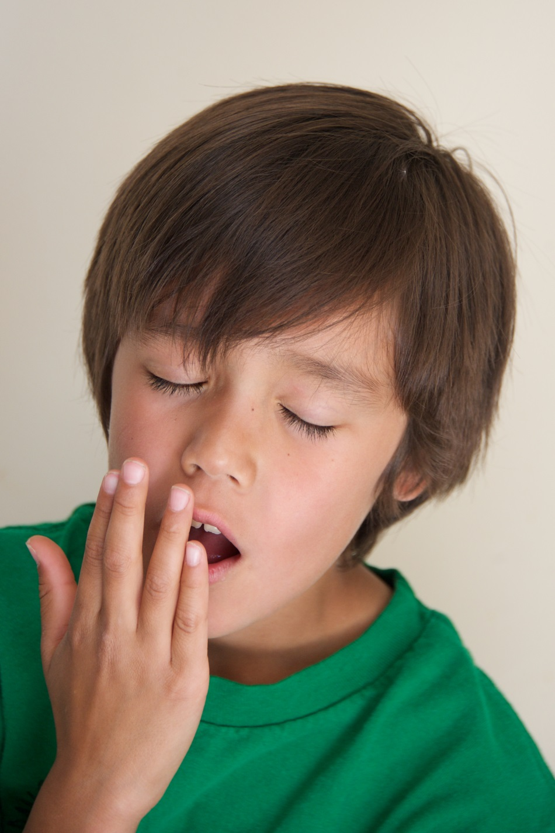
How are you?

Slide 2
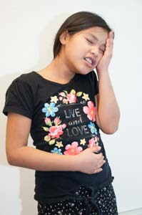
Yesterday I was sick.

Slide 3
Last night I was tired.

Slide 4
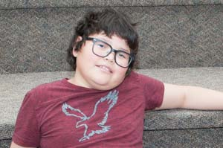
Right now I am relaxed (or resting).

Slide 5
This morning I was angry.

Slide 6
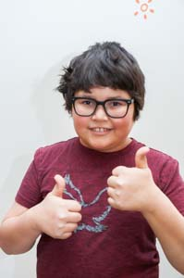
Today I’m good.

Slide 7
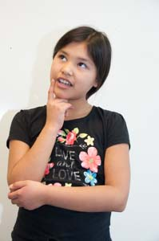
I wonder about tomorrow.

