Slide 1
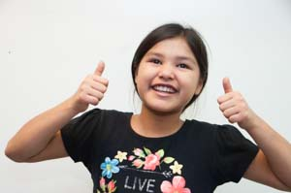
How are you?

Slide 2
Monday I was really good.

Slide 3
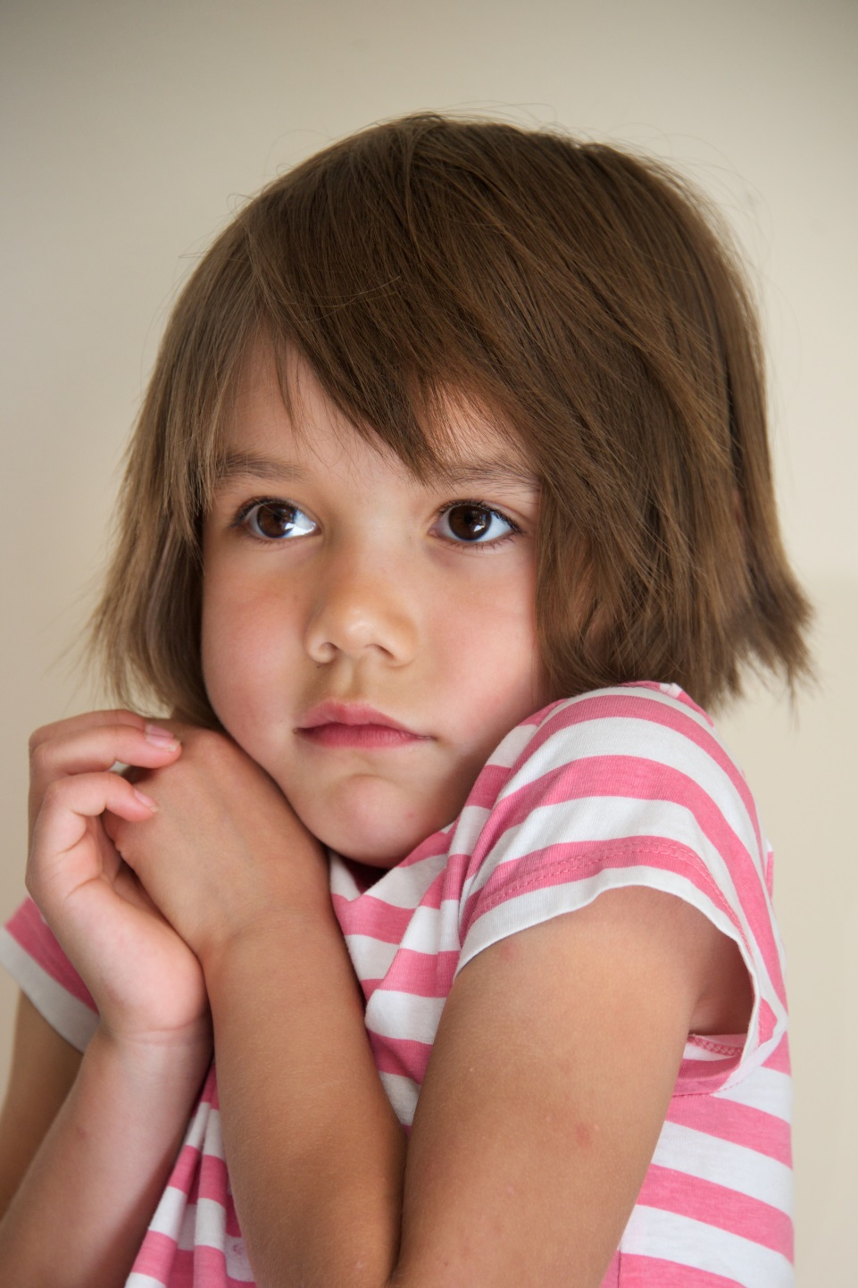
Tuesday I was shy.

Slide 4
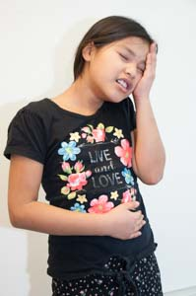
Wednesday I was sick.

Slide 5
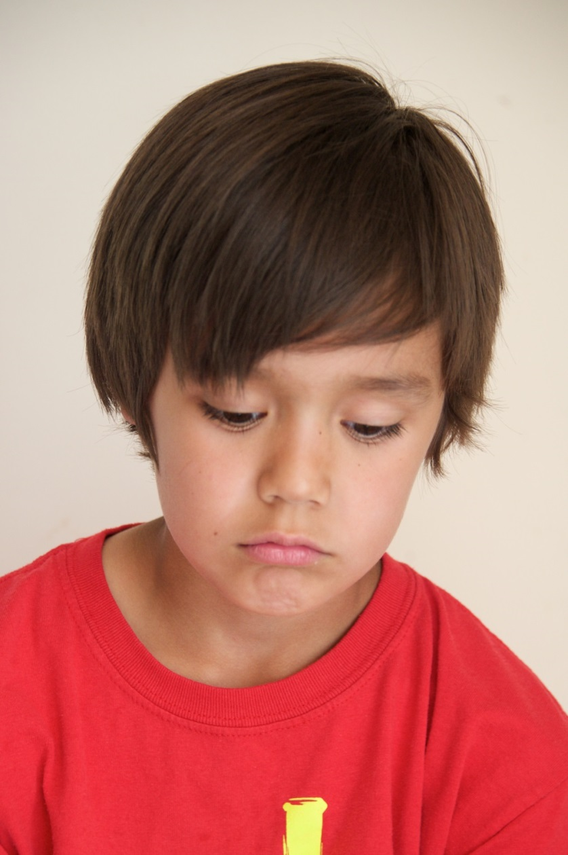
Thursday I was sad.

Slide 6
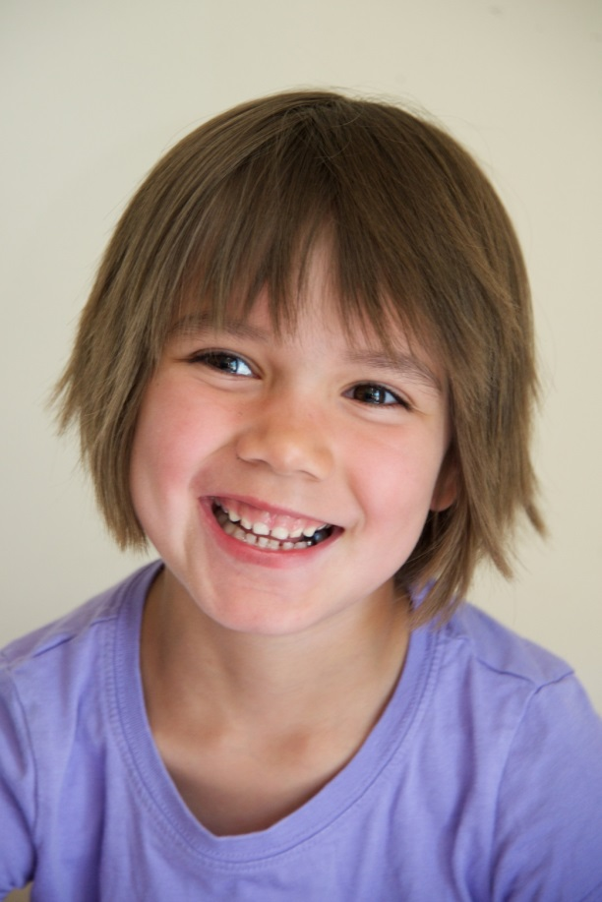
Friday I was happy.

Slide 7
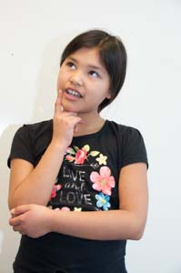
I wonder about tomorrow.

