Slide 1
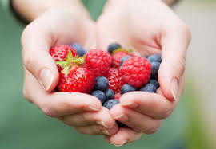
I Love Berries

Slide 2
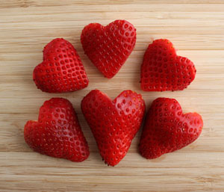
Strawberries, strawberries, strawberries
I love strawberries.

Slide 3
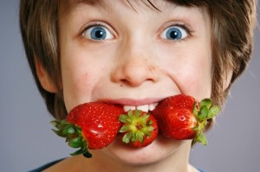
I eat strawberries at night.

Slide 4
I eat strawberries in the morning.

Slide 5
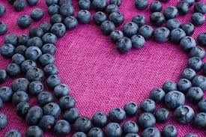
Blueberries, blueberries, blueberries
I love blueberries.

Slide 6
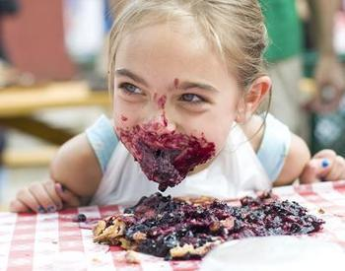
I eat blueberries with my mom.

Slide 7
I eat blueberries with my grandparents.

Slide 8
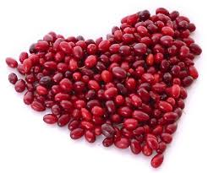
Cranberries, cranberries, cranberries
I love cranberries.

Slide 9
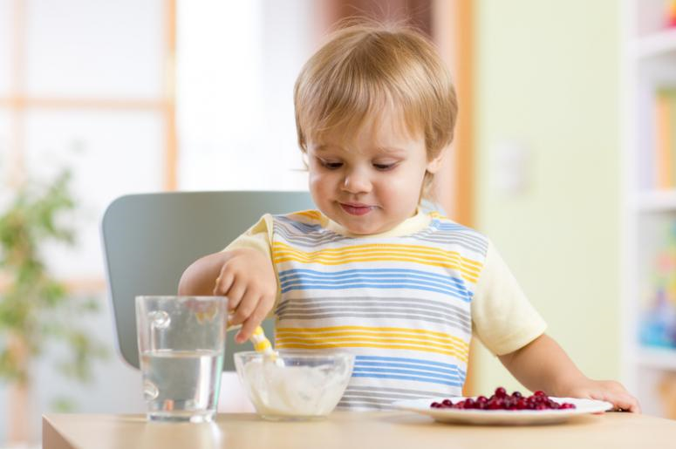
I eat cranberries in my room.

Slide 10
I eat cranberries in the kitchen

Slide 11
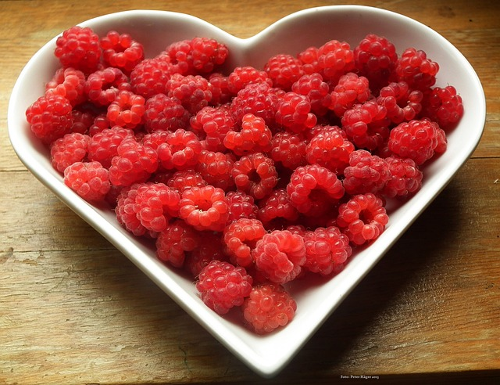
Raspberries, raspberries, raspberries
I love raspberries.

Slide 12
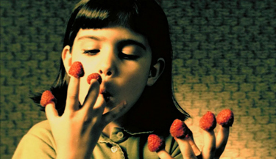
I eat raspberries on my bread.

Slide 13
I eat raspberries on bannock.

Slide 14
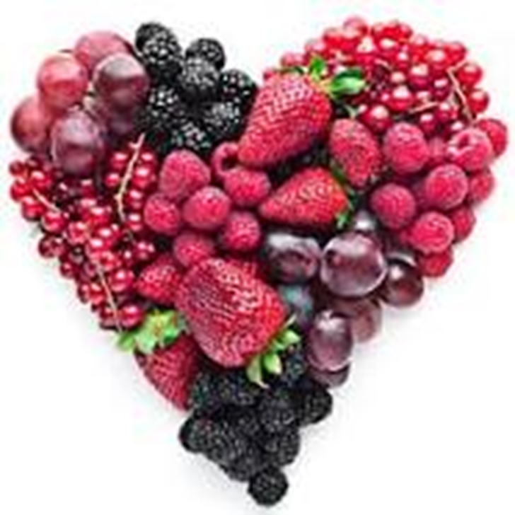
Berries, berries, berries.
I love berries.

Slide 15

Berries, berries, berries.
I don’t like berries.

