Slide 1
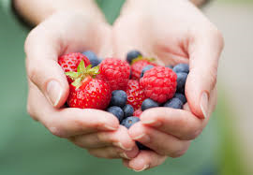
I Love Berries

Slide 2
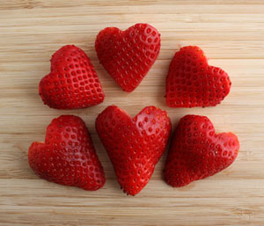
Strawberries, strawberries, strawberries I love strawberries.

Slide 3
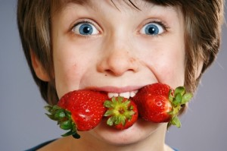
I eat strawberries in the morning. I eat strawberries at night. I eat strawberries all day long.

Slide 4
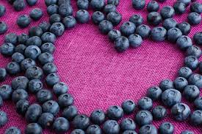
Blueberries, blueberries, blueberries I love blueberries.

Slide 5
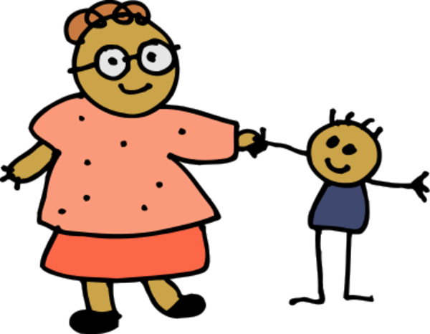
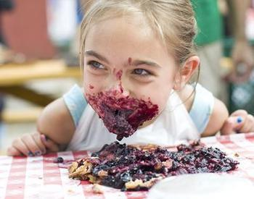
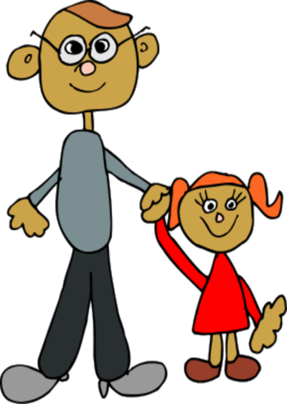
I eat blueberries with my mom. I eat blueberries with my dad. I eat blueberries with everyone.

Slide 6
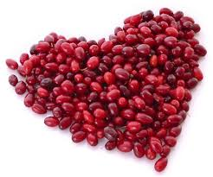
Cranberries, cranberries, cranberries I love cranberries.

Slide 7
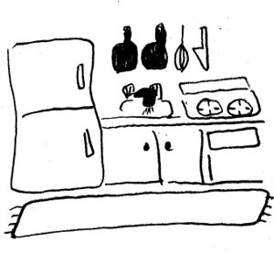
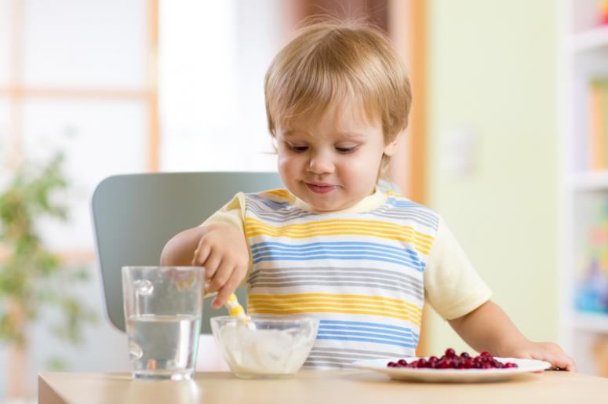
I eat cranberries in my kitchen. I eat cranberries in my room. I eat cranberries everywhere.

Slide 8
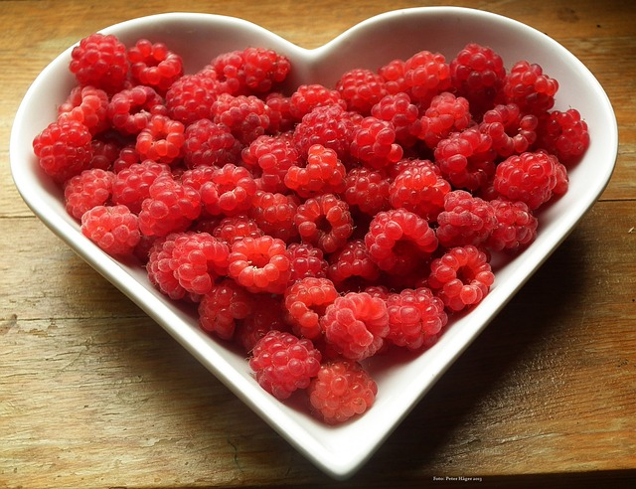
Raspberries, raspberries, raspberries I love raspberries.

Slide 9
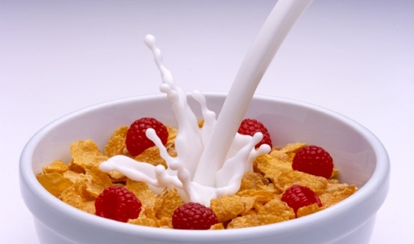
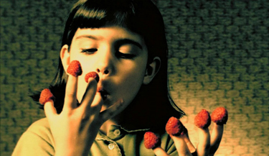
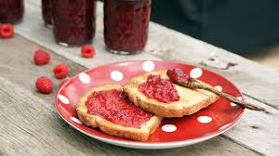
I eat raspberries on my cereal. I eat raspberries on my bread I eat raspberries on everything.

Slide 10
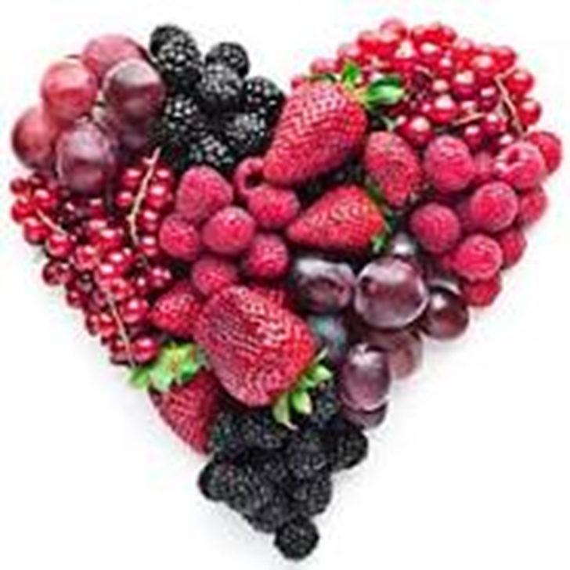
Berries, berries, berries. I love berries.

