Slide 1
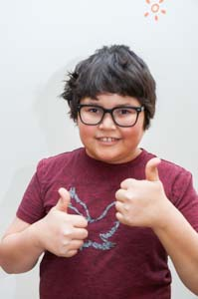
How are you?

Slide 2
I am good.

Slide 3
How are you?

Slide 4
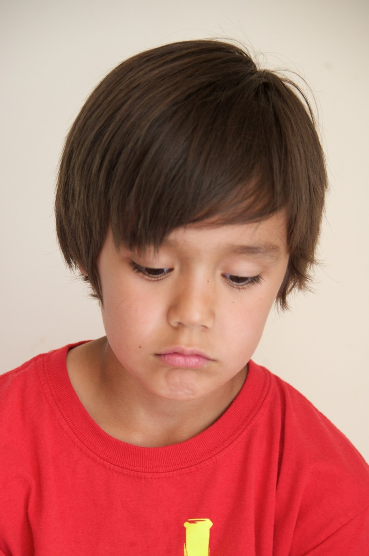
I am sad.

Slide 5
How are you?

Slide 6
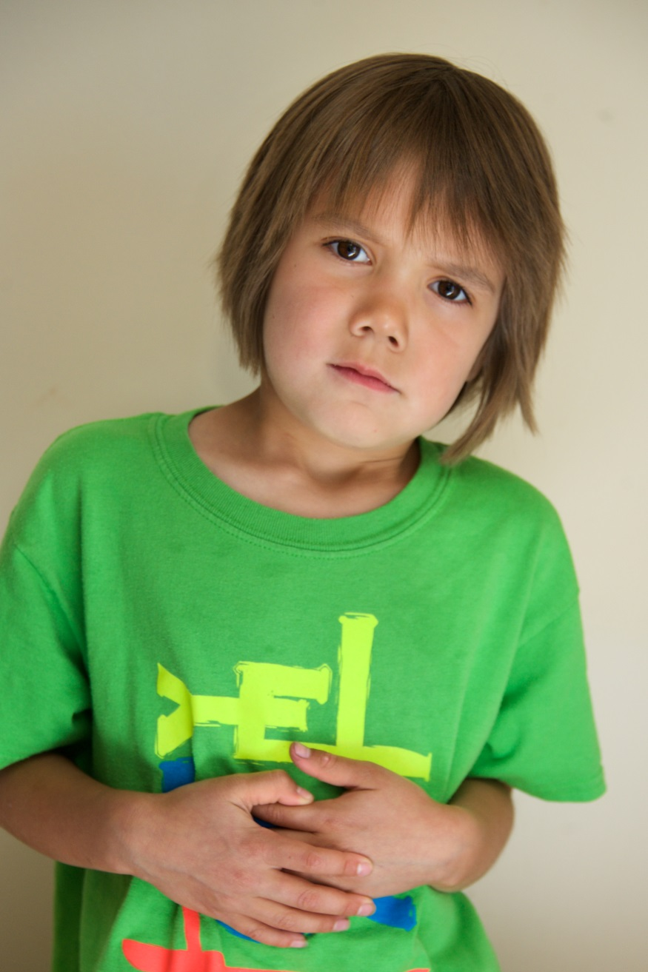
I am hungry.

Slide 7
How are you?

Slide 8
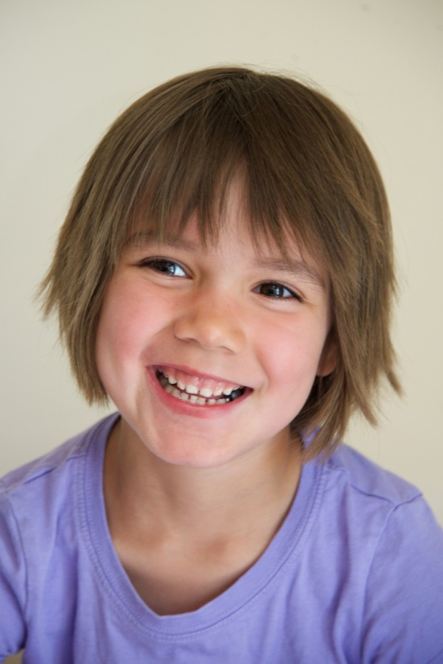
I am happy.

Slide 9
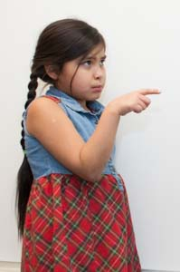
What about you?

